Slide 1



BTPN Syariah
Data Engineer Virtual Internship Program – February 2023
Enhancing Business Performance through
Segmentation Analysis Strategies
By Adrian Maulana Muhammad
https://github.com/adrn-mm/final-project-VIX-DE-BTPN

Slide 2

Table of Contents
Business Understanding
Data Understanding
Extract, Transform, and Load Process
Exploratory Data Analysis
Analytics Dashboard
Machine Learning: Classification
Summaries
Recommendations
References

Slide 3

Business Understanding

Slide 4

Background
The bank intends to enhance its business performance by using historical customer data to develop better marketing strategies, boost customer retention, and mitigate credit risk. To accomplish these objectives, the bank must comprehend its customers' attributes and pinpoint opportunities for increasing sales of additional products to existing customers while concurrently reducing churn rate and credit risk.

Slide 5
Problem Description
Based on the previously mentioned background, I have divided the problems in this project as follows:
The bank needs to utilize its historical customer data to segment customers into more targeted groups, helping it develop more effective marketing and selling strategies.
The bank needs to identify high credit-risk customers, enabling them to take appropriate preventive actions and reduce their credit risk.
The bank needs to analyze churn and identify the factors causing customers to discontinue using their services, thus helping them develop more effective retention strategies to retain customers.

Slide 6
Business Objectives
Based on the background explanation and problem description, I have formulated several business objectives for this project:
Conduct segmentation analysis by dividing customers into different groups based on their characteristics, such as customer status, age, gender, education, marital status, number of dependents, income, and type of credit card used. This will help the bank understand its customers better and develop more effective marketing strategies.
Perform credit risk analysis by examining data on credit limits, revolving balances, and credit utilization ratios to identify high-risk customers. This will help the bank take appropriate preventive action to reduce its credit risk.
Conduct churn analysis by looking at transactional activity, the total number of products used, and the total number of contacts made by the bank to identify the factors that cause customers to stop or continue using the bank's services. This will help the bank develop more effective retention strategies to keep customers loyal to their services.

Slide 7
Data Understanding

Slide 8
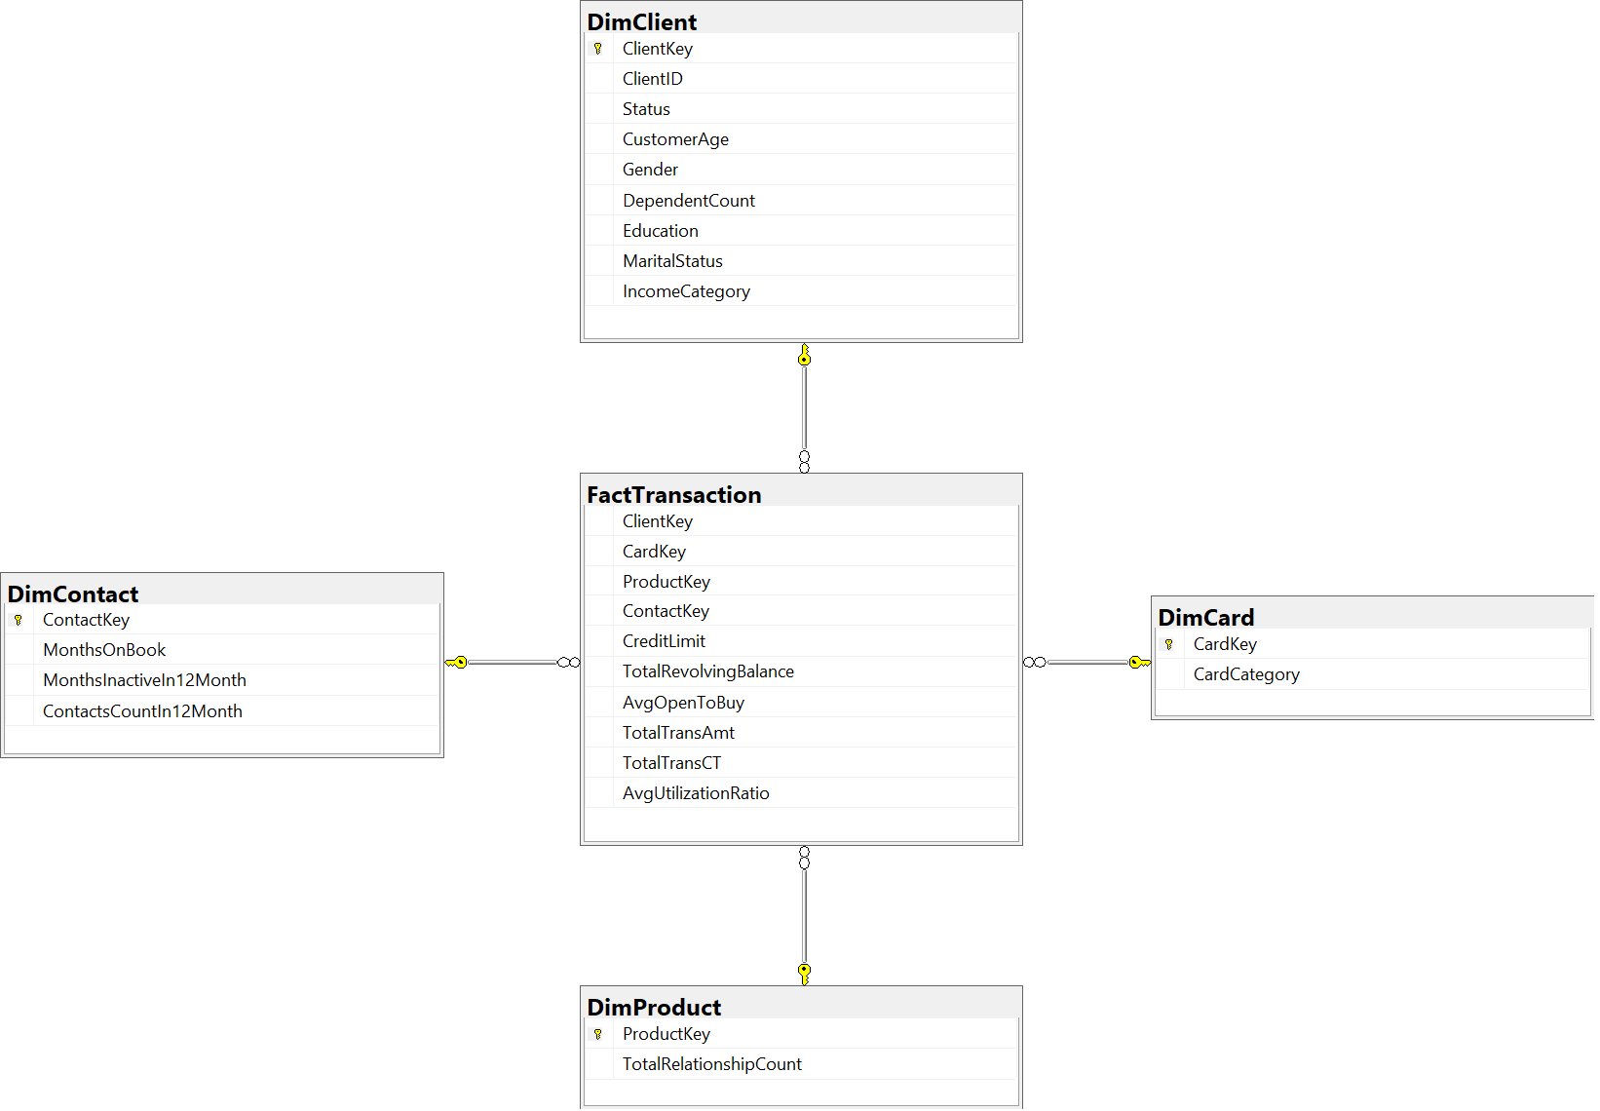
Data Model

Slide 9
Data Summaries
Table | Summary
FactTransaction | The transaction data and related information, such as the client, card, product, and contact involved in each transaction.
DimClient | Information about the clients, such as their key, name, age, gender, education level, marital status, income category, and dependent count.
DimCard | Information about the credit cards, such as their key, category, and type.
DimContact | Information about the contact channels, such as their key, inactive months in 12 months, contact count in 12 months, and months on book.
DimProduct | information about the bank products, such as their key, type, and total relationship count.

Slide 10
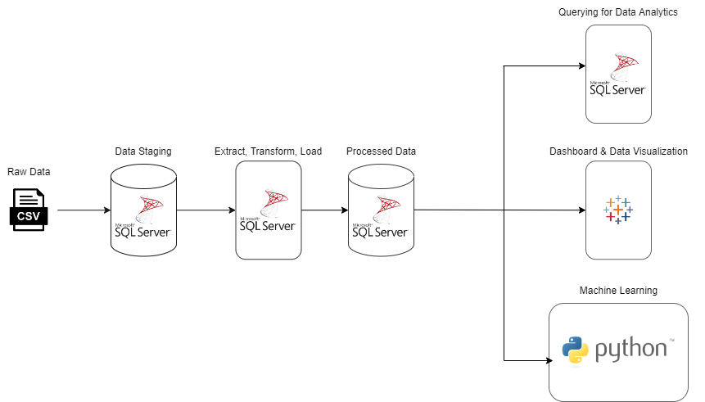
Data Pipeline

Slide 11
Extract, Transform, and Load Process

Slide 12
ETL Process Pipeline

